Slide 1
AZ-104T00A Administer Intersite Connectivity

Slide 2
Administer Intersite Connectivity Introduction
Configure VNet Peering
Configure VPN Gateway
Configure ExpressRoute and Virtual WAN
Lab 05 - Implement Intersite Connectivity
Notes:
Module overview

Slide 3
Configure VNet Peering

Slide 4
Configure VNet Peering Introduction
Determine VNet Peering Uses
Determine Gateway Transit and Connectivity Needs
Create VNet Peering
Determine Service Chaining Uses
Demonstration – VNet Peering
Summary and Resources
Notes:
Configure and manage virtual networking (25–30%)
Implement and manage virtual networking
* Create and configure virtual networks, including peering.

Slide 5
Determine VNet Peering Uses
Region 1
Region 2
VNet1
Global
VNet Peering
VNet2
Regional
VNet Peering
VNet3
Two types of peering: Global and Regional
Connects two Azure virtual networks – you can peer across subscriptions and tenants
Peered networks use the Azure backbone for privacy and isolation
Easy to setup, seamless data transfer, and great performance
Notes:
Virtual network peering - https://docs.microsoft.com/azure/virtual-network/virtual-network-peering-overview
Regional VNet peering connects Azure virtual networks in the same region.
Global VNet peering connects Azure virtual networks in different regions. When creating a global peering, the peered virtual networks can exist in any Azure public cloud region or China cloud regions, but not in Government cloud regions. You can only peer virtual networks in the same region in Azure Government cloud regions.
Private. Network traffic between peered virtual networks is private. Traffic between the virtual networks is kept on the Microsoft backbone network. No public Internet, gateways, or encryption is required in the communication between the virtual networks.
Performance. A low-latency, high-bandwidth connection between resources in different virtual networks.
Communication. The ability for resources in one virtual network to communicate with resources in a different virtual network, once the virtual networks are peered.
Seamless. The ability to transfer data across Azure subscriptions, deployment models, and across Azure regions.
No disruption. No downtime to resources in either virtual network when creating the peering, or after the peering is created.

Slide 6
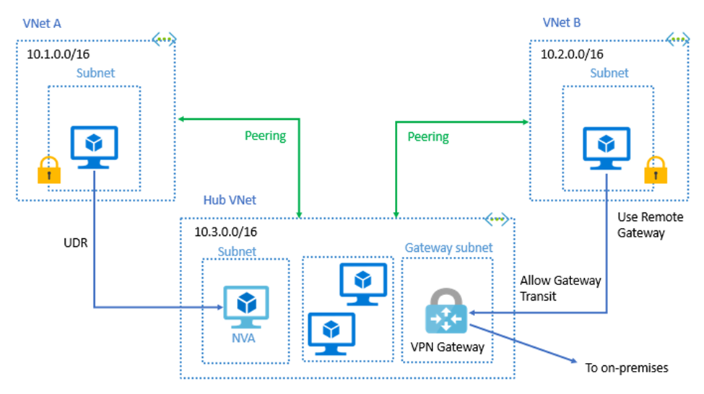

Determine Gateway Transit and Connectivity Needs
Gateway transit allows peered virtual networks to share the gateway and get access to resources
No VPN gateway is required in the peered virtual network
Default VNet peering provides full connectivity
IP address spaces of connected networks can't overlap
Notes:
Azure Virtual Network frequently asked questions (FAQ) VNet Peering - https://docs.microsoft.com/azure/virtual-network/virtual-networks-faq
A virtual network can have only one gateway. Gateway transit is supported for both VNet Peering and Global VNet Peering.
When you Allow Gateway Transit the virtual network can communicate to resources outside the peering. For example, the subnet gateway could:
Use a site-to-site VPN to connect to an on-premises network.
Use a VNet-to-VNet connection to another virtual network.
Use a point-to-site VPN to connect to a client.
In these scenarios, gateway transit allows peered virtual networks to share the gateway and get access to resources. This means you do not need to deploy a VPN gateway in the peer virtual network.

Slide 7
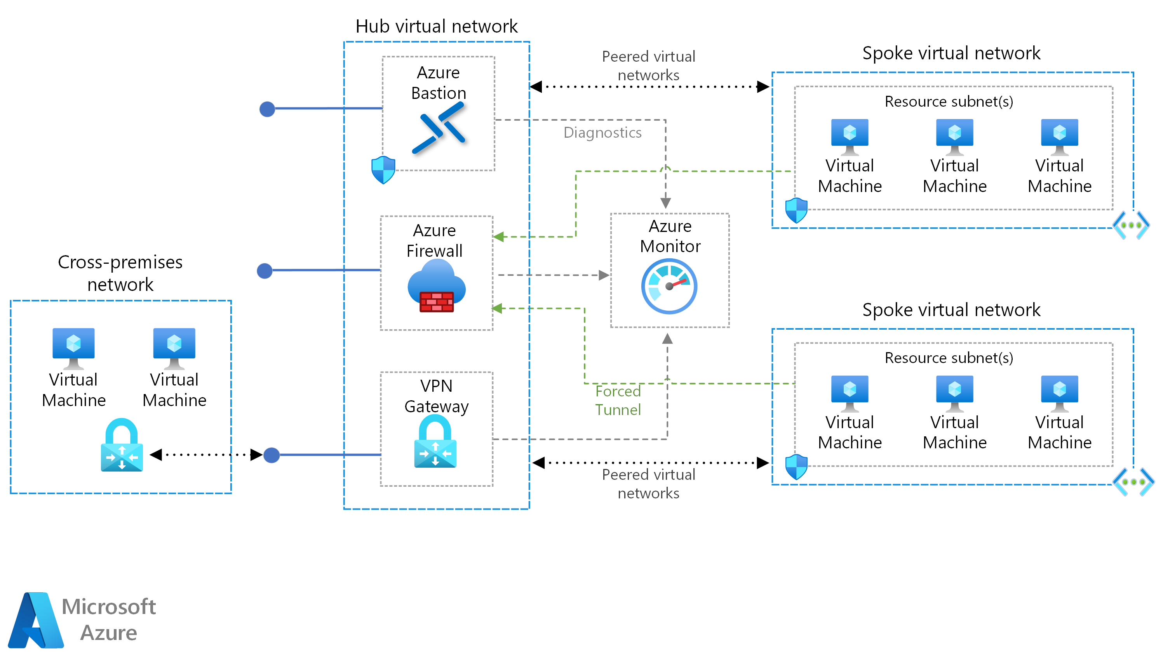
Review Hub and Spoke
Notes:
VNet Peering is nontransitive. When you establish VNet peering between VNet1 and VNet2 and between VNet2 and VNet3, VNet peering capabilities do not apply between VNet1 and VNet3.
Hub limitation is 500 max peering connections – this is a hard limit and cannot be over come.

Slide 8
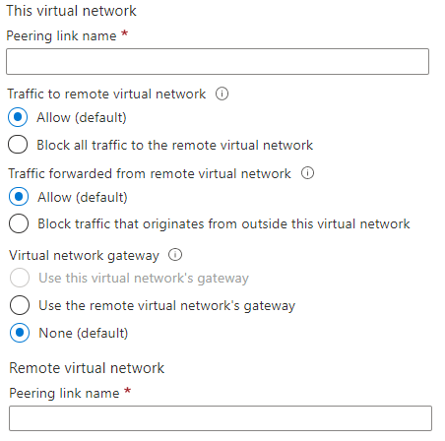
Create VNet Peering
Allow virtual network access settings
Configure forwarded traffic settings
Notes:
Create, change, or delete a virtual network peering - https://docs.microsoft.com/azure/virtual-network/virtual-network-manage-peering#requirements-and-constraints
Tutorial: Connect virtual networks with virtual network peering using the Azure portal - https://docs.microsoft.com/azure/virtual-network/tutorial-connect-virtual-networks-portal
✔️ When you add a peering on one virtual network, the second virtual network configuration is automatically added.

Slide 9
Determine Service Chaining Uses
Leverage user-defined routes and service chaining to implement custom routing
Implement a VNet hub with a network virtual appliance or a VPN gateway
VNet2
Hub VNet
Network Virtual Appliance or
VPN Gateway
Service chaining enables you to direct traffic from one virtual network to a virtual appliance, or virtual network gateway, in a peered virtual network, through user-defined routes
VNet3
Notes:
Distribute your services across Azure virtual networks and integrate them by using virtual network peering - https://docs.microsoft.com/learn/modules/integrate-vnets-with-vnet-peering
When you deploy hub-and-spoke networks, the hub virtual network can host infrastructure components like the network virtual appliance or VPN gateway. All the spoke virtual networks can then peer with the hub virtual network. Traffic can flow through network virtual appliances or VPN gateways in the hub virtual network.
Virtual network peering enables the next hop in a user-defined route to be the IP address of a virtual machine in the peered virtual network, or a VPN gateway.
Service chaining lets you define user routes. These routes direct traffic from one virtual network to a virtual appliance, or virtual network gateway.

Slide 10
Demonstration – VNet Peering
Configure VNet peering on the first virtual network
Configure a VPN gateway
Allow gateway transit
Confirm VNet peering on the second virtual network
Notes:
✔ Always consider having students walk-through the demonstrations themselves. Also, consider the overlap with the formal labs and your best use of time.

Slide 11
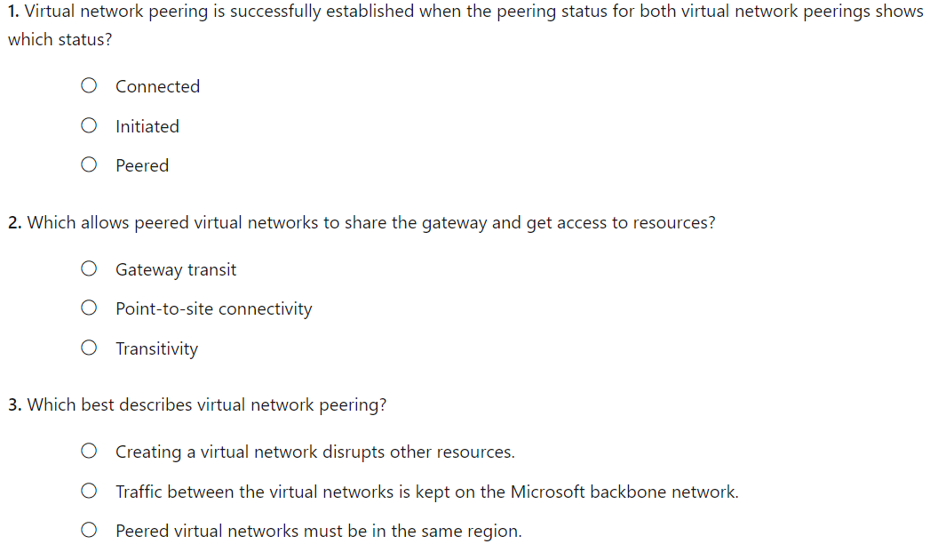
Knowledge Check
Notes:
A
B
B

Slide 12
Summary and Resources – Configure VNet Peering
Knowledge Check Questions
Microsoft Learn Modules (docs.microsoft.com/Learn)
Distribute your services across Azure virtual networks and integrate them by using virtual network peering (Sandbox)
A sandbox indicates a hands-on exercise.
Notes:
Learn - https://docs.microsoft.com/learn/browse/
The Assessment Guide in the MCT DLC has open-ended questions.
What is virtual network (VNet) peering and why would use it?
Answer: VNet peering connects two Azure virtual networks. Peering can be regional or global. Peered networks use the Azure backbone which provides for privacy and isolation. VNet peering is easy to configure and offers great performance.

Slide 13
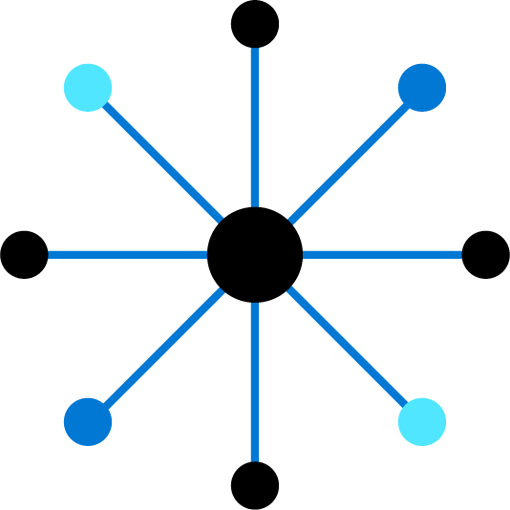
Lesson 02: Configure VPN Gateway

Slide 14
Configure VPN Gateway Introduction
Determine VPN Gateway Uses
Create Site-to-Site Connections
Demonstration- VPN Gateway
Create the Gateway Subnet
Create the VPN Gateway
Determine Gateway SKU and Generation
Create the Local Network Gateway
Setup the On-premises VPN Device
Create the VPN Connection
Determine High Availability Scenarios
Summary and Resources
Notes:
Configure and manage virtual networking (30-35%)
Integrate an on-premises network with an Azure virtual network
• Create and configure Azure VPN Gateway
• Create and configure VPNs

Slide 15




Determine VPN Gateway Uses
Azure
Point-to-Site
VNet 1
VNet 2
VNet-to-VNet
Local on-premises network
Site-to-Site
VNet-to-VNet connections connect Azure virtual networks – VNet peering or custom
Point-to-Site (User VPN) connections connect individual devices to Azure virtual networks
Site-to-Site connections connect on-premises datacenters to Azure virtual networks
Notes:
What is VPN Gateway? - https://docs.microsoft.com/azure/vpn-gateway/vpn-gateway-about-vpngateways
A VPN gateway is a specific type of virtual network gateway that is used to send encrypted traffic between an Azure virtual network and an on-premises location over the public Internet. You also use a VPN gateway to send encrypted traffic between Azure virtual networks over the Microsoft network.
Each virtual network can have only one VPN gateway. However, you can create multiple connections to the same VPN gateway. When you create multiple connections to the same VPN gateway, all VPN tunnels share the available gateway bandwidth.
Site-to-site connections connect on-premises datacenters to Azure virtual networks
VNet-to-VNet connections connect Azure virtual networks (custom)
Point-to-site (User VPN) connections connect individual devices to Azure virtual networks

Slide 16
Create Site-to-Site VPN Connections
Azure
On-premises
Azure
Public IP address
Create the Gateway Subnet
Create the VPN Gateway
Create the Local Network Gateway
Configure the VPN Device
Create the VPN Connection
IP or FQDN
Take time to carefully plan your network configuration
The on-premises part is necessary only if you are configuring Site-to-Site
Always verify and test your connections
Notes:
A virtual network gateway is composed of two or more VMs that are deployed to a specific subnet you create called the gateway subnet. Virtual network gateway VMs contain routing tables and run specific gateway services. These VMs are created when you create the virtual network gateway. You can't directly configure the VMs that are part of the virtual network gateway.
VPN gateways can be deployed in Azure Availability Zones. Availability zones bring resiliency, scalability, and higher availability to virtual network gateways. Availability Zones physically and logically separates gateways within a region, while protecting your on-premises network connectivity to Azure from zone-level failures.
The steps on this slide that are greyed out are not covered in the slides. Check the Extras Slides section at the end of the presentation for an older version slide. The blue steps have additional slides.
You could walk-thru the Tutorial: Create a site-to-site VPN connection in the Azure portal -https://docs.microsoft.com/azure/vpn-gateway/tutorial-site-to-site-portal
Connect your on-premises network to Azure with VPN Gateway - https://docs.microsoft.com/learn/modules/connect-on-premises-network-with-vpn-gateway/
Create the Gateway Subnet - When you create your gateway subnet, gateway VMs are deployed to the gateway subnet and configured with the required VPN gateway settings. Never deploy other resources (for example, additional VMs) to the gateway subnet.
Create the Local Network Gateway - Reflects the on-premises network configuration. Specify the IP address prefixes that will be routed through the gateway to the VPN device.

Slide 17
Demonstration – VPN gateways
Explore the Gateway subnet blade
Explore the Connected Devices blade
Explore adding a virtual network gateway
Explore adding a connection between the virtual networks
Notes:
✔ Always consider having students walk-through the demonstrations themselves. Also, consider the overlap with the formal labs and your best use of time.
Either do the demonstration or walk-through the slides.

Slide 18
Create the Gateway Subnet
When you create your gateway subnet, gateway VMs are deployed to the gateway subnet and configured with the required VPN gateway settings
The gateway subnet contains the IP addresses; if possible, use a CIDR block of /28 or /27
Never deploy other resources (for example, additional VMs) to the gateway subnet

Slide 19
Create the VPN Gateway
Most VPN Gateways are Route-based
Your choice of gateway SKU affects the number of connections you can have and the aggregate throughput benchmark
Associate the virtual network that includes the Gateway Subnet – need a public IP address
It can take up to 45 minutes to provision the VPN gateway
Notes:
The next slide is hidden but has the SKU and Generation example table.
Route-based VPNs use routes in the IP forwarding or routing table to direct packets. Route-based has support for IKEv2 and can use dynamic routing protocols.
Policy-based VPNs encrypt and direct packets through IPsec tunnels based on the IPsec policies. Policy-based only supports IKEv1 which some legacy on-premises VPN devices still use.
Wikipedia – BGP - Border Gateway Protocol is a standardized exterior gateway protocol designed to exchange routing and reachability information among autonomous systems on the Internet.

Slide 20
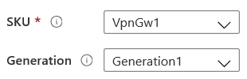
Determine Gateway SKU and Generation
Sampling of available SKUs
Gen | SKU | S2S/VNet-to-VNet Tunnels | P2S IKEv2 Connections | Throughput Benchmark
1 | VpnGw1/Az | Max. 30 | Max. 250 | 650 Mbps
1 | VpnGw2/Az | Max. 30 | Max. 500 | 1.0 Gbps
2 | VpnGw2/Az | Max. 30 | Max. 500 | 1.25 Gbps
1 | VpnGw3/Az | Max. 30 | Max. 1000 | 1.25 Gbps
2 | VpnGw3/Az | Max. 30 | Max. 1000 | 2.5 Gbps
2 | VpnGw4/Az | Max. 100 | Max. 5000 | 5.0 Gbps
2 | VpnGw5/Az | Max. 100 | Max. 10000 | 10.0 Gbps
The Gateway SKU affects the connections and the throughput
Resizing is allowed within the generation
The Basic SKU (not shown) is legacy and should not be used
Notes:
About VPN Gateway configuration settings - https://docs.microsoft.com/azure/vpn-gateway/vpn-gateway-about-vpn-gateway-settings
Create a route-based VPN gateway using the Azure portal - https://docs.microsoft.com/azure/vpn-gateway/create-routebased-vpn-gateway-portal
This table is just a sample of the SKUs that are available. There are many more.
Aggregate Throughput Benchmark is based on measurements of multiple tunnels aggregated through a single gateway. The Aggregate Throughput Benchmark for a VPN Gateway is S2S + P2S combined. The Aggregate Throughput Benchmark is not a guaranteed throughput due to Internet traffic conditions and your application behaviors.

Slide 21

Determine VPN Gateway Type
Route-based VPNs use routes in the IP forwarding or routing table to direct packets:
Support for IKEv2
Can use dynamic routing protocols
Policy-based VPNs encrypt and direct packets through IPsec tunnels based on the IPsec policies:
Support for IKEv1 only
Legacy on-premises VPN devices
Most VPN gateway configurations require a Route-based VPN

Slide 22
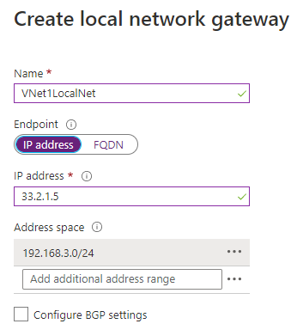
Create the Local Network Gateway
Reflects the on-premises network configuration
Give the site a name by which Azure can refer to it
Use a public IP address or FQDN for Local Network Gateway Endpoint
Specify the IP address prefixes that will be routed through the gateway to the VPN device

Slide 23
Create the On-premises VPN Device
Consult the list of supported VPN devices
Sampling of supported VPN devices
Vendor | Device Family
Barracuda Networks, Inc. | Barracuda CloudGen Firewall
Cisco | ASA, ASR, ISR
Citrix | NetScaler MPX, SDX, VPX
Juniper | SRX, J-Series, ISG, SSG
F5 | BIG-IP Series
Palo Alto Networks | All devices running PAN-OS
A VPN device configuration script may be available
Remember the shared key for the Azure connection
Specify the public IP address of the VPN Gateway
Notes:
About VPN devices and IPsec/IKE parameters for Site-to-Site VPN Gateway connections - https://docs.microsoft.com/azure/vpn-gateway/vpn-gateway-about-vpn-devices
Key things to remember
A shared key. The same shared key that you specify when creating the VPN connection.
The public IP address of your VPN gateway. The IP address can be new or existing.

Slide 24
Create the VPN Connection
Once your VPN gateways is created and the on-premises device is configured, create a connection object
Configure a name for the connection and specify the type as Site-to-site (IPsec)
Select the VPN gateway and the Local Network Gateway
Enter the Shared key for the connection

Slide 25
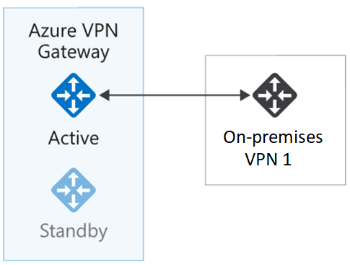
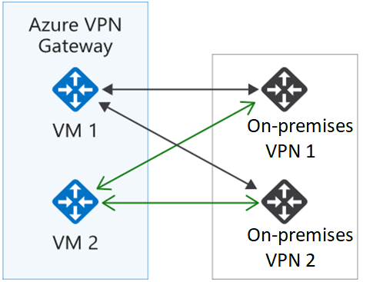
Determine High Availability Scenarios
Active/standby (default)
Active/active
VPN gateways are deployed as two instances
Enable active/active mode for higher availability
Notes:
Highly Available Cross-Premises and VNet-to-VNet Connectivity - https://docs.microsoft.com/azure/vpn-gateway/vpn-gateway-highlyavailable
Every Azure VPN gateway consists of two instances in an active-standby configuration. For any planned maintenance or unplanned disruption that happens to the active instance, the standby instance would take over (failover) automatically, and resume the S2S VPN or VNet-to-VNet connections. The switch over will cause a brief interruption. For planned maintenance, the connectivity should be restored within 10 to 15 seconds. For unplanned issues, the connection recovery will be longer, about 1 minute to 1 and a half minutes in the worst case. For P2S VPN client connections to the gateway, the P2S connections will be disconnected and the users will need to reconnect from the client machines.
Active/Active
In this configuration, each Azure gateway instance will have a unique public IP address, and each will establish an IPsec/IKE S2S VPN tunnel to your on-premises VPN device specified in your local network gateway and connection. Both VPN tunnels are actually part of the same connection. You will still need to configure your on-premises VPN device to accept or establish two S2S VPN tunnels to those two Azure VPN gateway public IP addresses.
When in active-active configuration, the traffic from your Azure virtual network to your on-premises network will be routed through both tunnels simultaneously. The same TCP or UDP flow will always traverse the same tunnel or path, unless a maintenance event happens on one of the instances.
When a planned maintenance or unplanned event happens to one gateway instance, the IPsec tunnel from that instance to your on-premises VPN device will be disconnected. The corresponding routes on your VPN devices should be removed or withdrawn automatically so that the traffic will be switched over to the other active IPsec tunnel. On the Azure side, the switch over will happen automatically from the affected instance to the active instance.

Slide 26
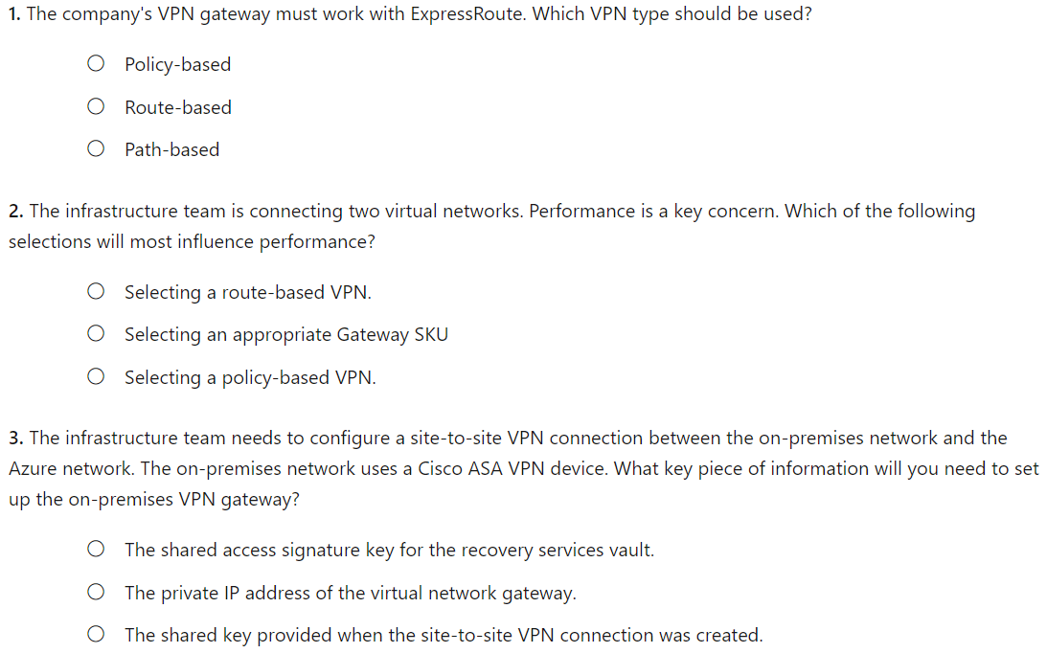
Knowledge Check
Notes:
B
B
C

Slide 27
Summary and Resources – Configure VPN Gateway
Knowledge Check Questions
Microsoft Learn Modules (docs.microsoft.com/Learn)
Introduction to Azure VPN Gateway
Connect your on-premises network to Azure with VPN Gateway (Sandbox)
A sandbox indicates a hands-on exercise.
Notes:
Learn - https://docs.microsoft.com/learn/browse/
The Assessment Guide in the MCT DLC has open-ended questions.
Describe at least three uses of a VPN gateway.
Answer: A VPN gateway can be used for site-to-site connections that connect on-premises datacenters to Azure virtual networks. A VPN gateway can be used for custom VNet-to-VNet connections between virtual networks. A VPN gateway can be used for point-to-site (User VPN) connections between individual devices and the Azure network. A VPN gateway is configured for VNet peering.
Explain two ways VPN gateways could be used in a high availability scenario.
Answer: In a high availability scenario two VPN gateways are deployed. The configuration can be either Active/Standby or Active/Active. In Active/Standby mode the second VPN gateway does not establish a connection until there is a failure. In Active/Active mode both gateway instances establish a connection.

Slide 28
Lesson 03: Configure ExpressRoute and Virtual WAN

Slide 29
Configure ExpressRoute and Virtual WAN Introduction
Determine ExpressRoute Uses
Determine ExpressRoute Capabilities
Coexist Site-to-Site and ExpressRoute
Compare Intersite Connection Options
Determine Virtual WAN Uses
Summary and Resources
Notes:
Configure and manage virtual networking (25–30%)
Integrate an on-premises network with an Azure virtual network
* Create and configure Azure ExpressRoute.
* Configure Azure Virtual WAN.

Slide 30
Determine ExpressRoute Uses
Primary Connection
Secondary Connection
ExpressRoute Circuit
Office 365, CRM
VNets, Apps
Partner
Edge
Microsoft
Edge
On-premises
Customer Network
Private connections between your on-premises network and Microsoft datacenters
Connections do not go over the public Internet – Partner network
Secure, reliable, low latency, high speed connections
Notes:
ExpressRoute - https://azure.microsoft.com/services/expressroute/

Slide 31
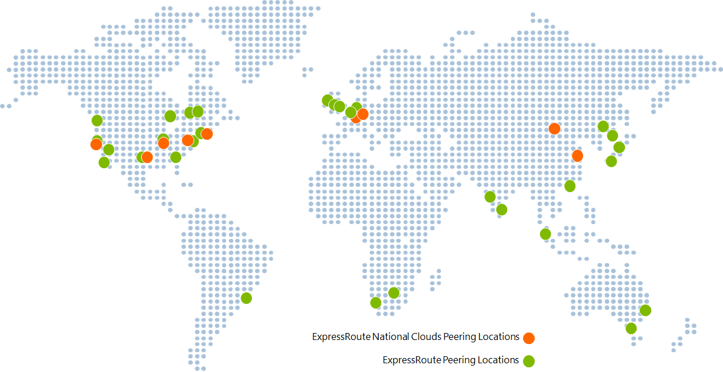
Determine ExpressRoute Capabilities
Layer 3 connectivity with redundancy
Connectivity to all regions within a geography
Global connectivity with ExpressRoute premium add-on
Across on-premises connectivity with ExpressRoute Global Reach
Bandwidth options – 50 Mbps to 100 Gbps
Billing models – Unlimited, metered, premium
Notes:
ExpressRoute overview - https://docs.microsoft.com/azure/expressroute/expressroute-introduction

Slide 32
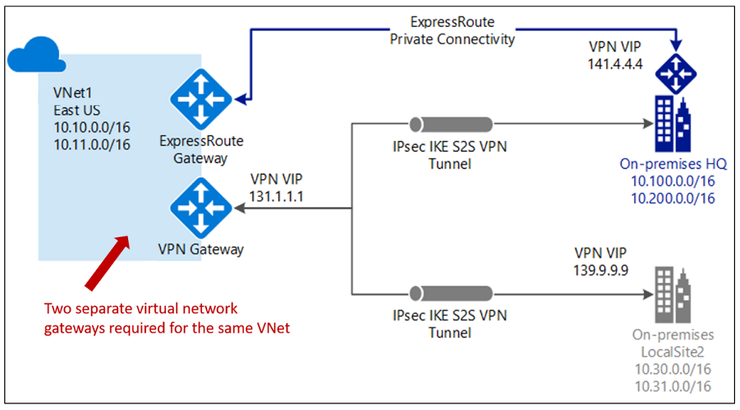
Coexist Site-to-Site and ExpressRoute
Use S2S VPN as a secure failover path for ExpressRoute
Use S2S VPNs to connect to sites that are not connected with ExpressRoute
Notice two VNet gateways for the same virtual network
Notes:
Tutorial: Create and modify an ExpressRoute circuit - https://docs.microsoft.com/azure/expressroute/expressroute-howto-circuit-portal-resource-manager
Connect your on-premises network to the Microsoft global network by using ExpressRoute - https://docs.microsoft.com/learn/modules/connect-on-premises-network-with-expressroute/
Two gateways (VPN & Expressroute) can be enabled on the same gateway subnet by using PowerShell.

Slide 33
Compare Intersite Connection Options
Connection | Azure services supported | Bandwidth | Protocols | Typical use case
Virtual network, point-to-site | Azure IaaS services, Azure Virtual Machines | Based on the gateway SKU | Active/passive | Dev, test, and lab environments for cloud services and virtual machines
Virtual network, site-to-site | Azure IaaS services, Azure Virtual Machines | Typically, <1 Gbps aggregate | Active/passive Active/active | Dev, test, and lab environments. Small-scale production workloads and virtual machines
ExpressRoute | Azure IaaS and PaaS services, Microsoft 365 services | 50 Mbps up to 100 Gbps | Active/active | Enterprise-class and mission-critical workloads. Big data solutions

Slide 34
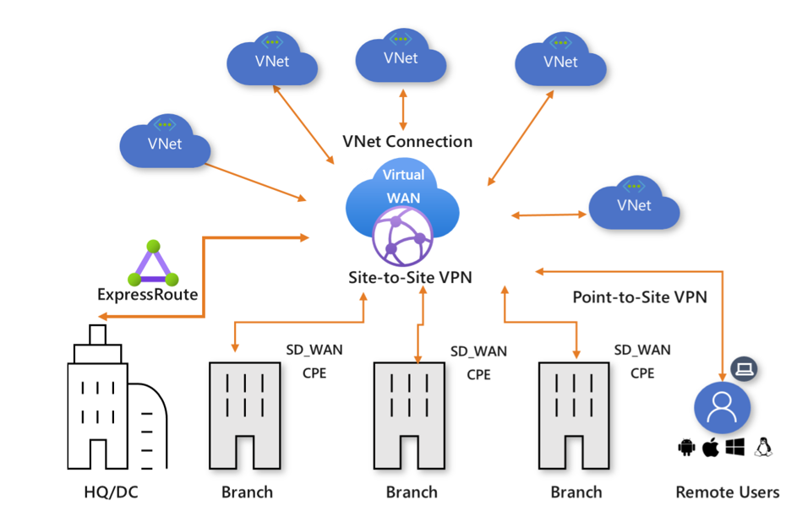
Determine Virtual WAN Uses
Brings together S2S, P2S, and ExpressRoute
Integrated connectivity using a hub-and-spoke connectivity model
Connect virtual networks and workloads to the Azure hub automatically
Visualize the end-to-end flow within Azure
Two types: Basic and Standard
Notes:
About Azure Virtual WAN - https://docs.microsoft.com/azure/virtual-wan/virtual-wan-about
Tutorial: Create a Site-to-Site connection using Azure Virtual WAN - https://docs.microsoft.com/azure/virtual-wan/virtual-wan-site-to-site-portal

Slide 35
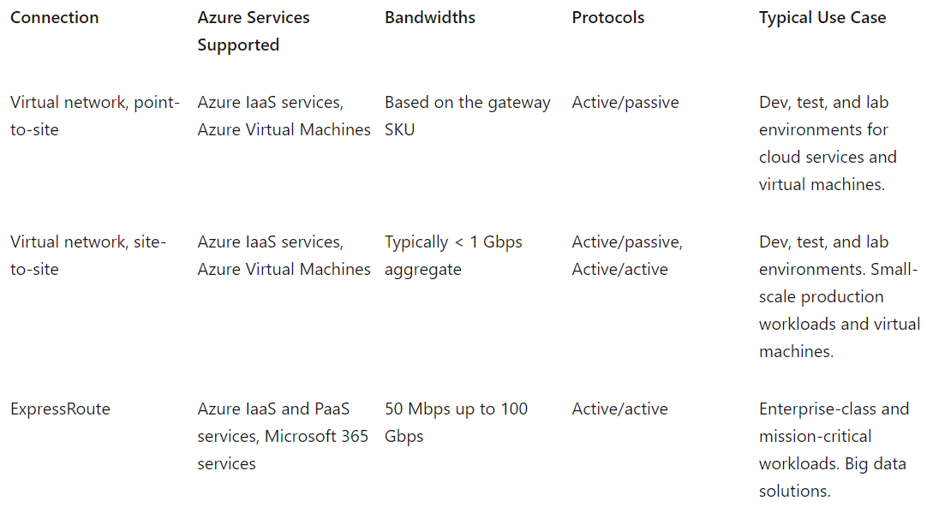
Connectivity Options

Slide 36
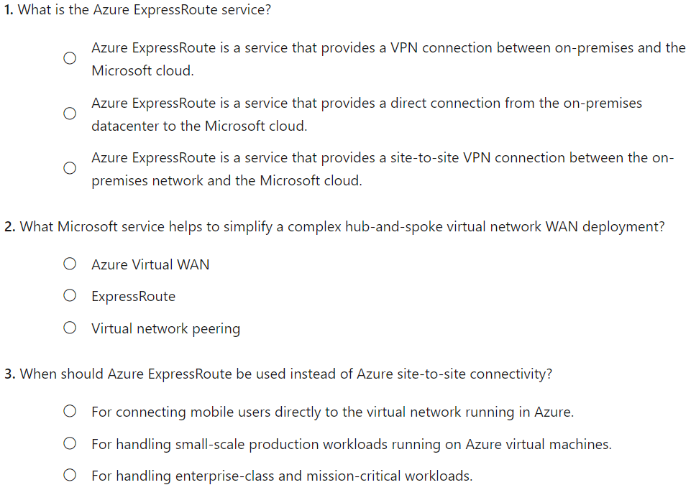
Knowledge Check
Notes:
B
A
C

Slide 37
Summary and Resources – Configure ExpressRoute and Virtual WANs
Knowledge Check Questions
Microsoft Learn Modules (docs.microsoft.com/Learn)
Introduction to Azure ExpressRoute
Design and implement Azure ExpressRoute
Introduction to Azure Virtual WAN
Notes:
Learn - https://docs.microsoft.com/learn/browse/
The Assessment Guide in the MCT DLC has open-ended questions.
Describe Azure ExpressRoute and at least three features.
Answer: Azure ExpressRoute creates private connections between Azure datacenters and infrastructure on your premises or in a colocation environment. ExpressRoute connections don't go over the public internet, instead connections use a partner network. ExpressRoute offers reliability, faster speeds, and lower latencies than typical internet connections. Bandwidth options are from 50 Mbps to 100 Gbps. Several billing options are available including unlimited, metered, and premium.
Describe Azure Virtual WAN (VWAN) and at least three features.
Answer: Azure VWAN is a networking service that brings many networking, security, and routing functionalities together. Azure VWAN can combine site-to-site, point-to-point, and ExpressRoute connections. VWAN provides integrated connectivity with a hub-spoke topology. VWAN makes it easy to connect workloads and visualize the end-to-end flow. VWAN has two pricing options, basic and standard.

Slide 38
Lab 05 - Implement Intersite Connectivity

Slide 39
Lab 05 – Implement intersite connectivity
Lab scenario
Contoso has its datacenters in Boston, New York, and Seattle offices connected via a mesh wide-area network links, with full connectivity between them. You need to implement a lab environment that will reflect the topology of the Contoso's on-premises networks and verify its functionality
Objectives
Task 1:
Provision the lab environment
Task 2:
Configure local and global virtual network peering
Task 3:
Test intersite connectivity
Next slide for an architecture diagram
Notes:
LAB 05 - Implement Intersite Connectivity - ESTIMATED DURATION 30 MIN
GitHub Repository - https://microsoftlearning.github.io/AZ-104-MicrosoftAzureAdministrator/

Slide 40




Lab 05 – Architecture diagram
Region1
Task 1
az104-05-rg1
az104-05-vnet0 10.50.0.0/22
Region2
Subnet0 10.50.0.0/24
Task 2, Task 3
az104-05-rg1
az104-05-vm0
10.50.0.4
Global Peering
az104-05-vnet2 10.52.0.0/22
Subnet0 10.52.0.0/24
az104-05-rg1
Local Peering
Global Peering
az104-05-vm2
10.52.0.4
Subnet0 10.51.0.0/24
az104-05-vm1
10.51.0.4
az104-05-vnet1 10.51.0.0/22

Slide 41

End of presentation

